Slide 1
Text Analytics – Basics Of NLP

Slide 2

Natural Language Processing
NLP is a branch of data science that consists of systematic processes for analyzing, understanding, and deriving information from the text data in a smart and efficient manner
Natural language processing is actually an umbrella term that includes two related methods: Natural Language Understanding and Natural Language Generation.
Notes:
Image link: https://i1.wp.com/aliz.ai/wp-content/uploads/2019/05/Natural-Language-Processing-03-1.png?fit=3042%2C1521&ssl=1
Notes:
Natural Language Processing (NLP) is a branch of Artificial Intelligence that enables machines to understand human language and respond in kind. This involves training them to process text and speech and interpret the meaning of words, sentences and paragraphs in context. By utilizing NLP and its components, one can organize the massive chunks of text data, perform numerous automated tasks and solve a wide range of problems such as – automatic summarization, machine translation, named entity recognition, relationship extraction, sentiment analysis, speech recognition, topic segmentation, etc.
Human-machine ‘conversations’ or interactions can be broken down as follows:
We provide text or speech input (e.g. typing into a chatbot interface or talking to a smart speaker).
The machine converts the text/speech into a format it understands (e.g. converts speech to text and words to vectors). This helps in clustering and classifying different words.
The machine then figures out the meaning and context using its own data. An appropriate response is determined and converted to text or speech that we can understand, and dishes them out
Natural language processing is actually an umbrella term that includes two related methods: Natural Language Understanding and Natural Language Generation.
Natural language understanding (NLU) figures out the meaning behind text and speech. This involves taking unstructured text and speech input from humans and converting it to structured formats that machines can understand. When you ask Alexa for a weather report, for example, it uses natural language understanding to figure out what you’re saying.
Natural language generation (NLG) refers to computer-generated text and speech. NLG turns structured data into text and speech that humans can understand. Continuing our previous example, Alexa uses natural language generation when it responds ‘It is sunny today. Would you like to place an order for sunglasses?’

Slide 3
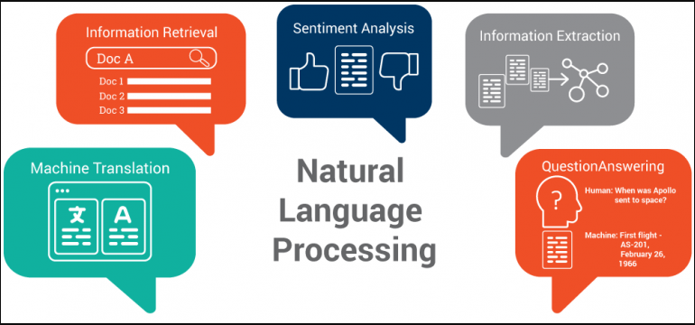
Notes:
Image Link: https://image.ibb.co/kkaABL/NLP-768x356.png

Slide 4
Some Applications of NLP
Speech Recognition
Sentiment Analysis
Spam Detection
Machine Translation
Chatbot
Text Classification
Notes:
Notes:
Machine Translation - is the process by which computer software is used to translate a text from one natural language to another
Speech Recognition - is the process by which a computer (or other type of machine) identifies spoken words
Sentiment Analysis - is the process of detecting positive or negative sentiment in text; often used by businesses to detect sentiment in social data, gauge brand reputation, and understand customers
Chatbot - a chatbot is a software application used to conduct an on-line chat conversation via text or text-to-speech, in lieu of providing direct contact with a live human agent
Text Classifications - the process of categorizing the text into a group of words; by using NLP, text classification can automatically analyze text and then assign a set of predefined tags or categories based on its context
Spam Detection - detect unsolicited, unwanted, and virus-infested email (called spam) and stop it from getting into email inboxes
The application aspects of NLP are vast and these just scratch the surface of what is yet to be discovered.

Slide 5
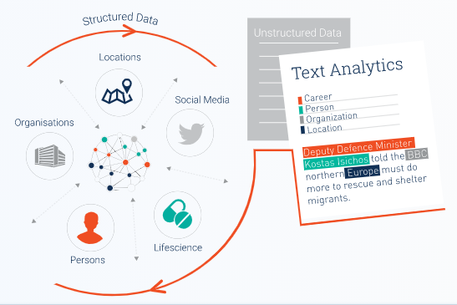
Components of NLP
Lexical Analysis - with lexical analysis, we divide a whole chunk of text into paragraphs, sentences, and words; involves identifying and analyzing structure of words
Syntactic Analysis - involves the analysis of words in a sentence for grammar and arranging words in a manner that shows the relationship among the words
Semantic Analysis - draws the exact meaning for the words, and it analyzes the text meaningfulness
Disclosure Integration - it takes into account the context of the text and considers the meaning of the sentence before it ends
Pragmatic Analysis - deals with overall communication and interpretation of language
Notes:
Image: https://ontotext.com/wp-content/uploads/2019/09/Text-Mining-and-Analytics_Technical-Solutions-Leveraging-Tailored-Text-Mining.svg

Slide 6
NLP In Banking
Some applications of Natural Language Processing in Banking:
Intelligent Document Search:
Finding relevant information in large volumes of scanned document.
Investment Analysis: Automating routine analysis of earnings reports and news so that analysts can focus on alpha generation.
Customer Service & Insights:
Deploying chatbots to answer customer queries and understand customer needs.
Notes:
Notes:
Banks may apply natural language processing to large volumes of text and speech data to extract information, gain insights, and streamline manual tasks. While time and cost savings are obvious benefits, the ability to identify key information (the proverbial needle in the haystack) can be a competitive difference maker.
The three areas where banks are applying natural language processing are Intelligent Document Search, Investment Analysis, Customer Service & Insights.
Intelligent Document Search
JP Morgan Chase’s COIN (Contract Intelligence) software uses natural language processing to help the bank’s legal team search and review large volumes of legal documents.
COIN can reportedly save the bank’s legal team 360,000 hours, or 15,000 days, of document search tasks per year. It can extract key data and clauses to help loan officers review commercial loan agreements, for example.
COIN is apparently trained to recognize key information (attributes) within documents that the bank’s legal team flags as important. This enables the software to extract key information from documents that are structured differently. The bank claims it extracted 150 relevant attributes from 12,000 commercial credit agreements in seconds.
The software’s workings are not public since it’s used internally. We can speculate that it could be powered by natural language processing (to search within documents), optical character recognition (to recognize characters in scanned documents), and machine learning (to classify & cluster data within documents and to improve search algorithms over time).
These methods can be applied to other banking activities. It can help banks extract types of customer data that they don’t have time to track. This data could help predict customer needs and identify cross-selling opportunities. It can also speed up Know Your Customer (KYC) processes that require document analysis, thereby making customer onboarding easier.
Investment Analysis
Securities research desks at banks are using natural language processing to find valuable insights within mountains of company reports and conference calls.
Banks previously hired armies of analysts to comb through earnings reports and other filings and enter pertinent data into databases and valuation models.
Now, banks are using natural language processing tools that ‘read’ hundreds of documents at a time and summarize key information for human analysts. Speech analysis tools can ‘listen’ to analyst conference calls to determine the tone and sentiment behind what company management is saying, which can provides insight for equity analysis. These tools are huge time savers and allow analysts to focus on alpha generation.
Banks also use natural language processing for sentiment analysis. These tools analyze large volumes of news and social media posts to extract key insights, determine how a company is perceived, or track market reaction to significant events. These timely insights can inform analyst recommendations.
Banks either use tools developed internally or by vendors. One vendor, Dataminr, claims to analyze social media and financial news to identify relevant information including unexpected news, emerging trends, or risks.
Customer Service & Insights
Major banks are introducing some level of customer service automation through chatbots. In early 2019, Bank of America launched Erica, a mobile virtual assistant, which soon amassed over one million users through the BofA mobile app.
Erica accepts voice and text commands and combines predictive analytics with natural language processing to help customers:
Check balances and transfer money
Searching for past transactions and account info on demand
Track spending habits (probably using predictive analytics, which is a value-add that encourages more chatbot usage)
Help customers manage recurring or late payments
Chatbots let customers access account information and perform basic transactions on their phone instead of using internet banking or visiting their local branch. Executing transactions through a clean chatbot interface may also take less time.
A bigger win for banks will be using natural language processing for customer insights. Using methods related to intelligent document search and sentiment analysis described above, banks can better understand and predict customer needs and pain points. Sentiment analysis tools can monitor social media to see what people are saying about the bank. Document search tools can analyze feedback forms and customer information to respond to issues, offer tailored products, and increase customer retention.

Slide 7
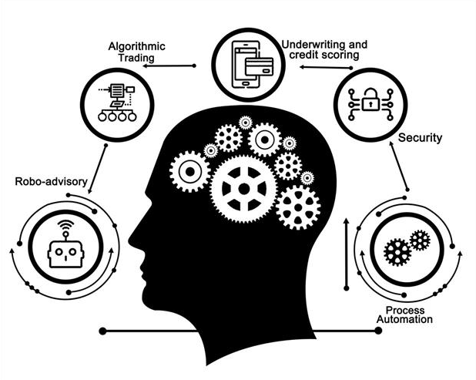
Unearthing Potential Of NLP In Banking
By analyzing text and speech data more quickly and extracting more actionable insights on customers and the market, banks can serve customers better and make better investments
The potential for greater market share and income are the real difference makers
Banks may apply natural language techniques to any function that processes large volumes of text or speech data such as in compliance, risk management, order execution, and so on
Notes:
Image: https://menafn.com/updates/pr/2020-04/02/G_c09de87e-9image_story.jpeg
Notes:
Banking leaders realize that natural language processing can automate routine document analysis, research, and customer service.
Cost savings are just the tip of the iceberg. By analyzing text and speech data more quickly and extracting more actionable insights on customers and the market, banks can serve customers better and make better investments. The potential for greater market share and income are the real difference makers.
While we have not covered all possible use cases, banks can apply natural language techniques to any function that processes large volumes of text or speech data. There are numerous applications in compliance, risk management, or order execution, for example.
Key considerations include whether to build AI and natural language processing tools in-house or to license software from an AI vendor. Building in-house requires data scientists, developers, and an organizational AI strategy. While this takes time, internally developed solutions might meet the bank’s needs better than a vendor product. In addition, data quality and availability across departments also have to be addressed.
Given the broad range of banking activities that natural language processing can be applied to, banks that apply these solutions across departments are likely to see far greater returns on investment.

Slide 8
Python Case Study – Basics of Text Analytics
Objective:
Exploring and conducting analysis on text data using existing as well as ingested data
Dataset:
IMDB movie review dataset available in Kaggle has been made use of for our purpose, which comprises of both the review and the ratings assigned for several different movies.

Slide 9
Python Case Study – Basics of Text Analytics
Data Handling:
Handling of text and JSON files using built-in functions and python libraries
Text manipulation using ‘regular expressions’ module
Text Pre-Processing:
Case conversion using built-in functions
Removal of punctuations using ‘regular expressions’ and ‘string’ modules
Dropping the stop words (those which do not impart any meaning to text) using NLTK library

Slide 10
Python Case Study – Basics of Text Analytics
Text Pre-Processing:
Spell checking of data using TextBlob, a python library for textual data processing
Splitting chunks of text data into tokens, the process which is regarded as tokenization, is undertaken using ‘regular expression’, NLTK and SpaCy libraries
Stemming and lemmatization of text data utilizing Porter and Snowball stemmers for the former, and WordNetLemmatizer method for the latter all of which are available in the NLTK library

Slide 11
Python Case Study – Basics of Text Analytics
Text Pre-Processing:
Tagging parts of speech by making use of appropriate methods in the NLTK and SpaCy libraries
Identifying and classifying the named entities into various pre-defined classes with the help of NLTK and SpaCy

Slide 12
Python Case Study – Basics of Text Analytics
Data Ingestion Using APIs:
Ingesting data from Twitter in the form of tweets and their authors with Tweepy, an open source python package that gives easy and convenient access to the Twitter API via python
Collecting data using GoogleNews which aggregates news data from thousands of different publishers and magazines

Slide 13
Thank You!

